Slide 1

Symfony Dockerized
Maximizing Microservices

Slide 2
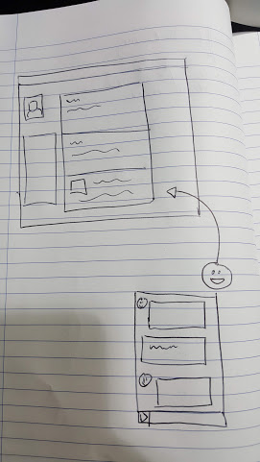

Slide 3
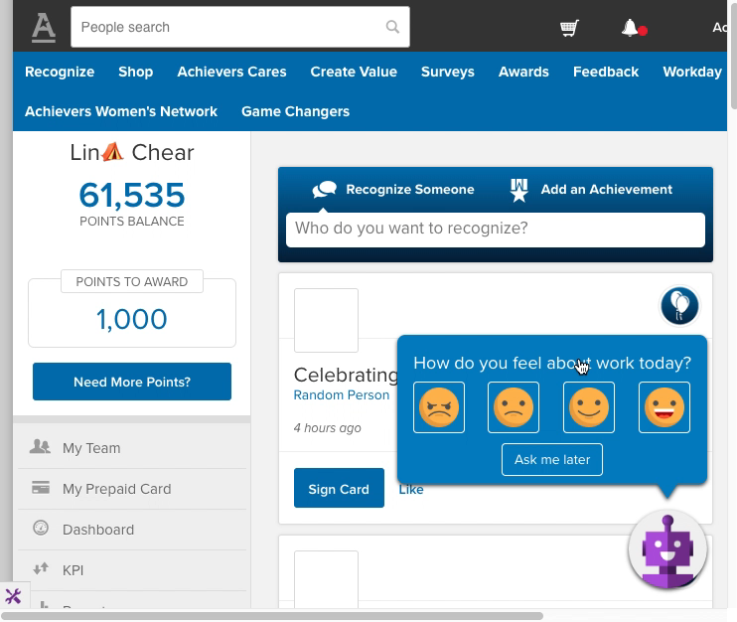

Slide 4


Slide 5
Requirements
New Product
New Market
Minimal Infrastructure
No Impact

Slide 6
What?
Symfony
PHP Framework
Organize and Develop Complex Applications
Docker
Container Technology
Build, Package and Deploy Applications
MicroService
Discretely Functional
Loosely Coupled
Independently Developed and Deployed Software

Slide 7
Why Symfony?
https://symfony.com/
PHP Shop – Developers Developers Developers
Proven Framework
Active Development
Widely Used - (stackoverflow!)
Bundles Packaging – composer based
Easily Extensible
Database Agnostic
Shallow Learning Curve

Slide 8
Why Docker? (Microservice?)

Slide 9
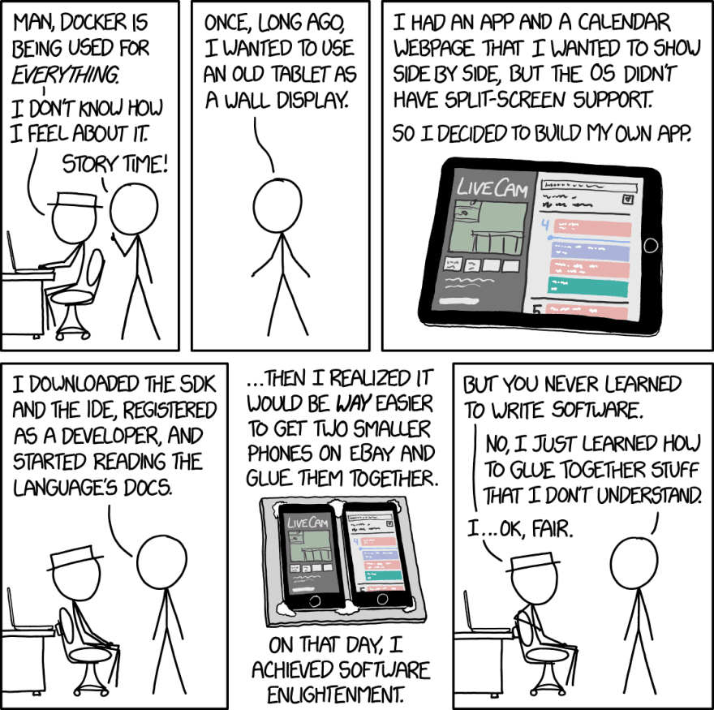

Slide 10
Why Docker? (Microservice?)
Docker - Everyone said so
Widely Used
Container Technology
Simplified Deployment
Build Once, Deploy Many
Minimal Impact
Independent Deployments

Slide 11
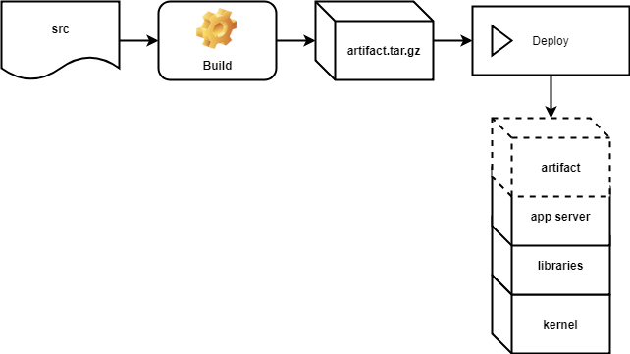
How? - Traditional
Dependency Mismatch
External Dependencies
Different services = Different dependencies
Provisioning Servers per Service
Harder to Scale

Slide 12
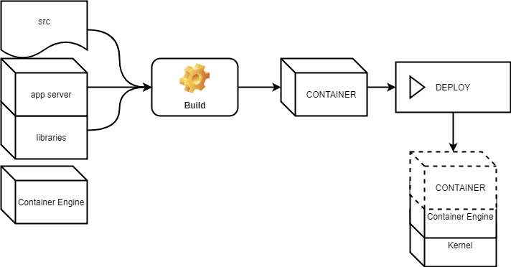
How? - Containers!

Slide 13
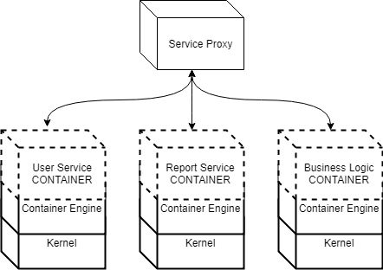
How? - Microservices
Notes:
Provisioning container engines is easy - Helps with scaling

Slide 14
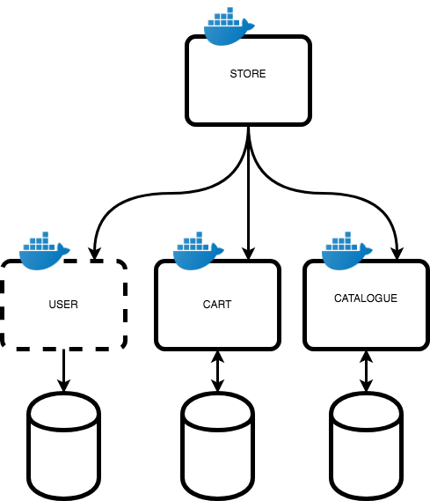
Docker & Symfony - CODE

Slide 15
Docker & Symfony - CODE
GET /user/{id}
POST /user/
[
id,
name
]

Slide 16
Challenges
Container-Code Sync
Deploying Code
Building with composer
Configuration Settings
Accessing credentials / secrets
Orchestrating different containers
Service Reuse

Slide 17
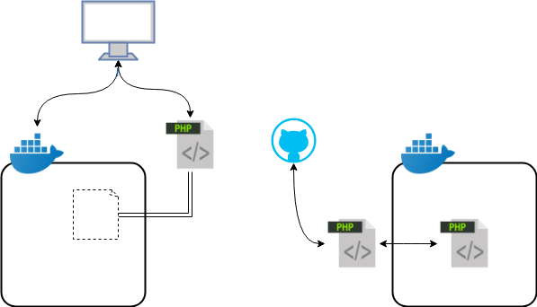
Container Code Sync

Slide 18
Volumes - Mapping
# docker-compose.yml
…
services:
symfony_app:
volumes:
- ./local/src:/container/src
#
docker run –ti –v “$(PWD)/src”:/container/src ...

Slide 19
Volumes - Embedding
# build.sh
git archive master --format=tar.gz -o src.tar.gz
# Dockerfile
ADD ./src.tar.gz /container/src

Slide 20
Challenges
Container Code Sync
Deploying Code
Building with composer
Configuration Settings
Accessing credentials / secrets
Orchestrating different containers
Service Reuse

Slide 21
Deploying Code – Composer Install
# Dockerfile...
ADD ./src.tar.gz /src/
RUN cd /src/ && composer install --no-dev --optimize-autoloader
Improves start up time of container
Reduces network pull on container startup
Creates static source image

Slide 22
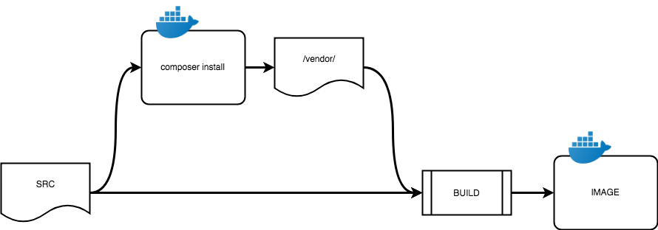
Composer Install Pipeline

Slide 23
Symfony Commands Runtime
# Dockerfile
CMD /opt/scripts/startup.sh
#!/bin/sh
cd /src/
php bin/console ...
Clear and Build Cache
Run Migration Scripts etc.

Slide 24
Challenges
Container Code Sync
Deploying Code
Building with composer
Configuration Settings
Accessing credentials / secrets
Orchestrating different containers
Service Reuse

Slide 25
Environmentalize Parameters
#parameters.yml
env(PROJECT_DATABASE_PORT): 3306
doctrine:
dbal:
host: ‘%env(PROJECT_DATABASE_HOST)%’
port: ‘%env(PROJECT_DATABASE_PORT)%’

Slide 26
SECRETS
$ cd /run/secrets/
$ ls
database_password
api_password
$ cat api_password
my_api
env(DB_PASSWORD): ‘/run/secrets/database_password’
env(API_PASSWORD): ‘/run/secrets/api_password’
database_password: “%env(file:DB_PASSWORD)%”
api_password: “%env(file:API_PASSWORD)%”

Slide 27
Challenges
Container Code Sync
Deploying Code
Building with composer
Configuration Settings
Accessing credentials / secrets
Orchestrating different containers
Service Reuse

Slide 28
docker compose
#docker-compose.yml
services:
user_service:
…
report_service:
…
database:
…

Slide 29
Challenges
Container Code Sync
Deploying Code
Building with composer
Configuration Settings
Accessing credentials / secrets
Orchestrating different containers
Service Reuse

Slide 30
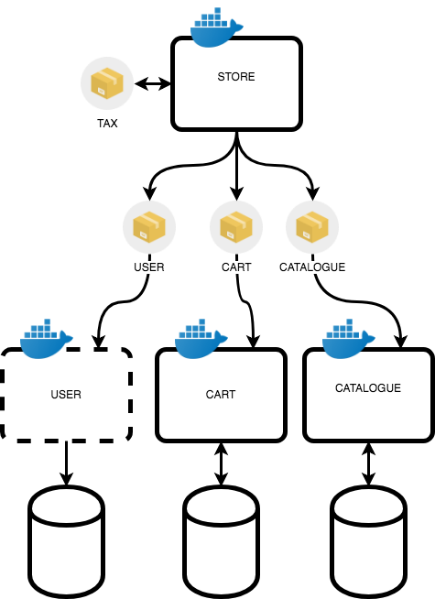
Service Reuse
Notes:
* Add Slide to preview what we're going to work on and steps
* go deeper into docker

Slide 31
Development Work Arounds
Debugging?
Production and Development Containers
Simulated Deployment docker-compose.yml
Unit Tests?
Separate container / volume mounted
Production Containers Used for Deployable Environments
QA, Staging, etc.

Slide 32
QUESTIONS?????

